Slide 1
What is the model in Neuron Network?
(By a Layer of Neuron)
Notes:
123

Slide 2
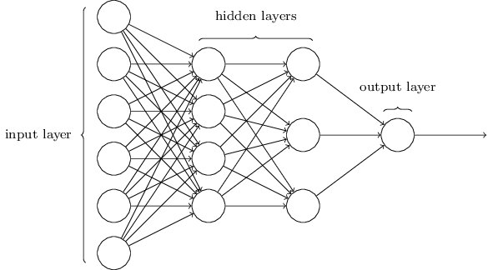
(Feature vector)
Single Neuron
Notes:
123

Slide 3
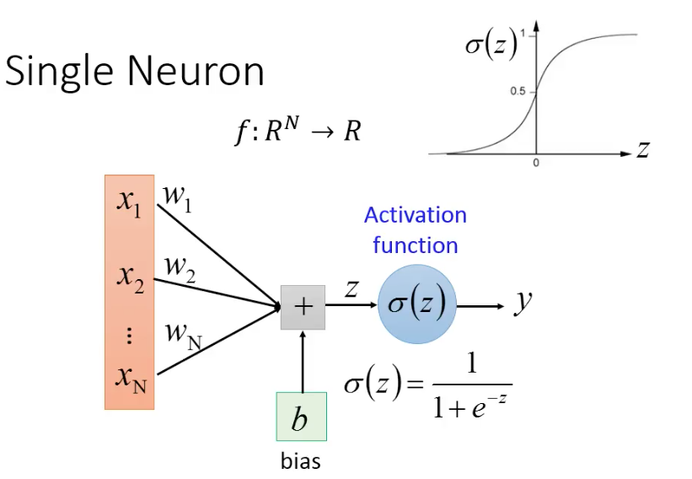
inner product：goo.gl/BimsQ6
Copy short URL

Slide 4
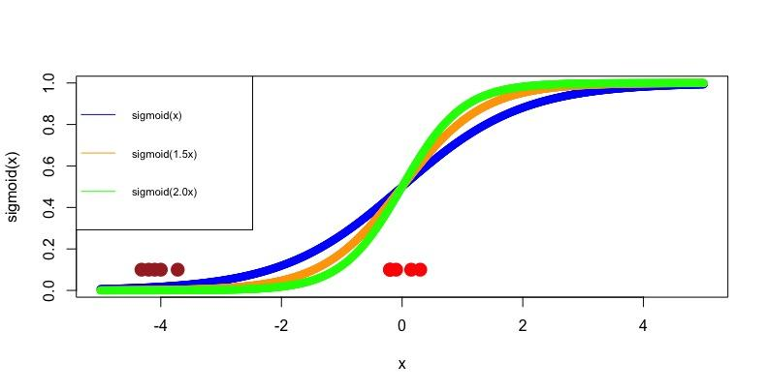


Slide 5
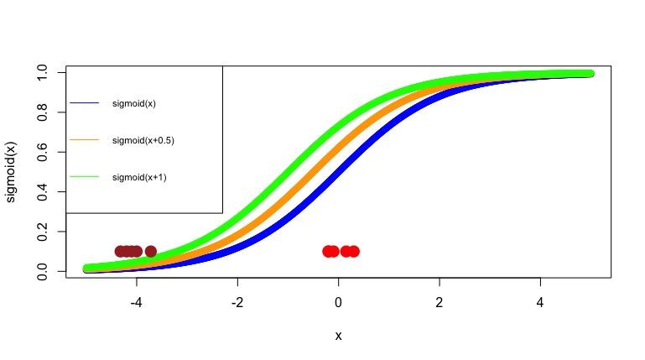

Slide 6

Iinearity
non-linearity
three neurons
(no activation function)
three neurons
(activation function)

Slide 7


Limitation of Single Neuron
Input vector：
Weight vector：
Activation Function：
Output：
Threshold
Binary classification

Slide 8
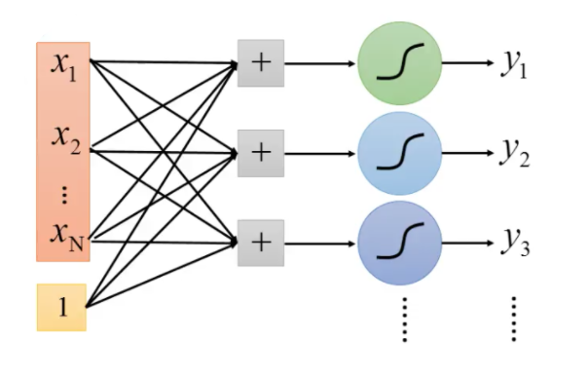
Single Layer (multiple neuron)
“1” or not
“2” or not
“3” or not
10 Neuron

Slide 9
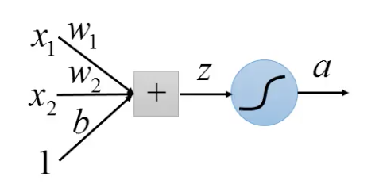



Limitation of Single Layer
binary classification
1
 |  | Output
0 | 0 | Yes
0 | 1 | No
1 | 0 | No
1 | 1 | Yes
0
0
1

Slide 10
 |  | Output
0 | 0 | Yes
0 | 1 | No
1 | 0 | No
1 | 1 | Yes
If and only if (若且為若)：
“若x1則x2” 且 “若x2則x1”
“若非x1則非x2” 且 “若非x2則非x1”

Slide 11
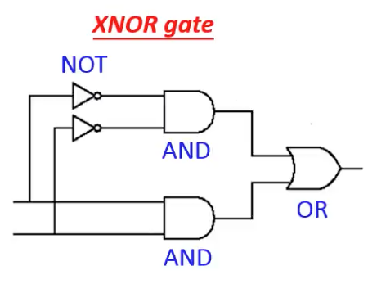
 |  | Output
0 | 0 | Yes
0 | 1 | No
1 | 0 | No
1 | 1 | Yes
1
0
1
0
1
0
1
1
0
1
0
1
0
1

Slide 12



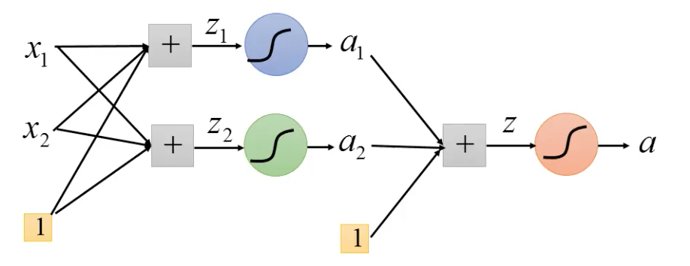
 |  |  |  |  | Output
0 | 0 | 1 | 0 | 1 | Yes
0 | 1 | 0 | 0 | 0 | No
1 | 0 | 0 | 0 | 0 | No
1 | 1 | 0 | 1 | 1 | Yes
layer 1
(hidden layer)
Intput layer
output layer

Slide 13
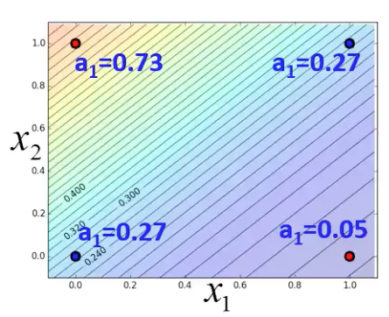
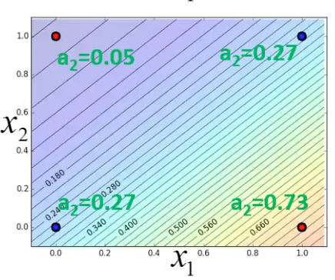
1

Slide 14
(0.73,0.05)
0.5
(0.05,0.73)
(0.27,0.27)
0.5

Slide 15
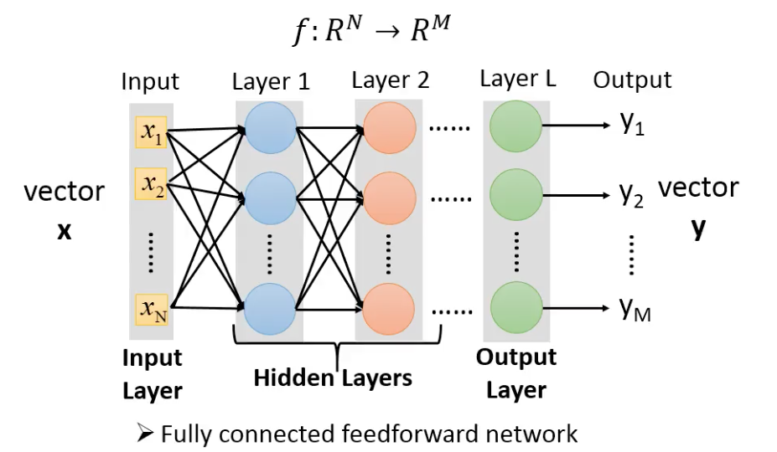

Slide 16
Next....
Notation
Cost Function
Gradient descent

